Slide 1

The Toastmasters Educational Program
The Successful Club Series
CD 300A

Slide 2
Introduction
Successful Club Series
  10-15 minute educational speeches
  Focused on improving club meetings
  Based on Standard script with PowerPoint
  Fulfills requirements of ACS and ALB awards
TM Program (#300)
  Describes the TM program
  Proven curriculum that
    Develops communication & leadership skills
    Provides rewards & recognition for achievements
  Carefully crafted programs designed to
    Teach, practice and provide feedback

Slide 3
Toastmasters Educational Program
Club Officer
District Officer
Club Mentor or Coach
Club Sponsor or Speechcraft or Youth Leadership Program
Chosen Path 1 (e.g., Presentation Mastery)
Level 1
Mastering Fundamentals
Level 2
Learning Your Style
Level 3
Increasing Knowledge
Level 4
Building
Skills
Level 5
Demonstrating Expertise
New
Member
Capstone Project
Distinguished Toastmaster
Chosen Path 2 (e.g., Team Collaboration)
Level 1
Mastering Fundamentals
Level 2
Learning Your Style
Level 3
Increasing Knowledge
Level 4
Building
Skills
Level 5
Demonstrating Expertise
59 Projects
27-30 Speeches
1 Capstone project
2 of 10 Paths

Slide 4
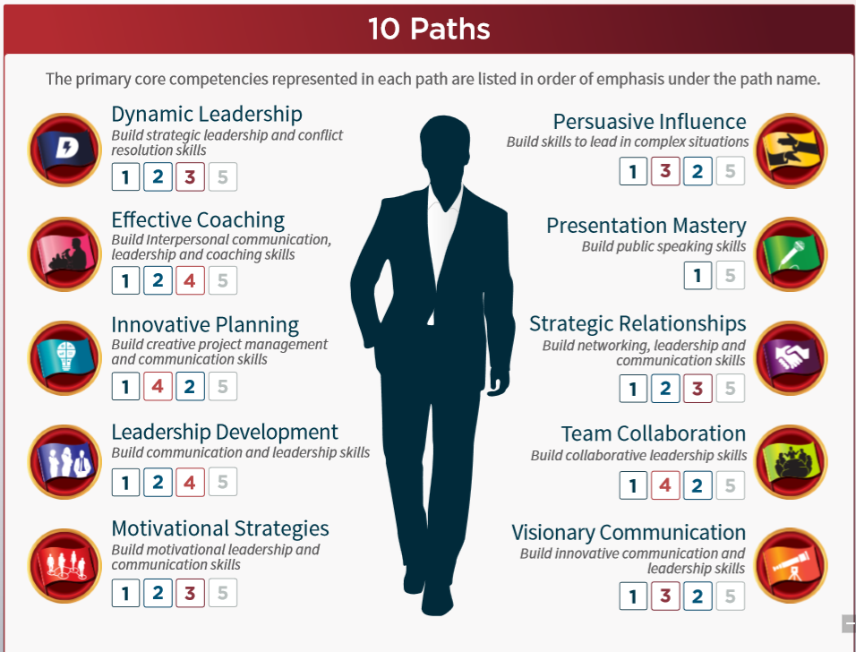
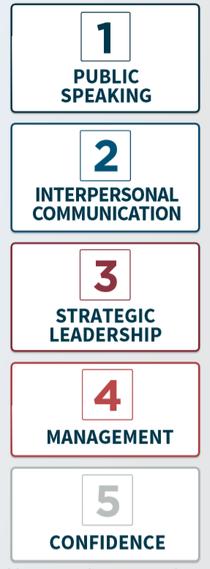
Paths develop Core Competencies
4
https://www.toastmasters.org/~/media/C74952D666414797BE9B165B739B7CF9.ashx

Slide 5
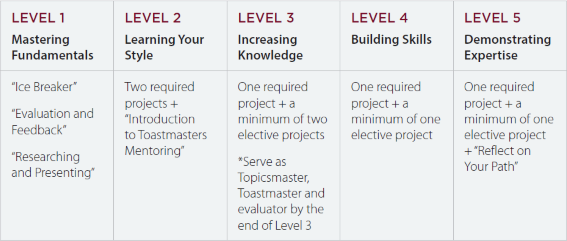
Levels of Complexity
More details can be found on the District 4 site:
http://www.d4tm.org/index.php/pathways/paths-and-projects.html
5

Slide 6
Pathways: Levels 1 and 2
✓ Required
 | Level 1 |  |  | Level 2
Project Path | Icebreaker | Evaluation & Feedback | Researching & Presenting | Leadership Style | Communication Style | Intro. to Mentoring | Connect w/ Audience | Managing Time | Active Listening | Eff. Body Language | Cross Culture
Dynamic Leadership | ✓ | ✓ | ✓ | ✓ | ✓ | ✓
Effective Coaching | ✓ | ✓ | ✓ | ✓ | ✓ | ✓
Innovative Planning | ✓ | ✓ | ✓ | ✓ |  | ✓ | ✓
Leadership Development | ✓ | ✓ | ✓ | ✓ |  | ✓ |  | ✓
Motivational Strategies | ✓ | ✓ | ✓ |  | ✓ | ✓ |  |  | ✓
Persuasive Influence | ✓ | ✓ | ✓ | ✓ |  | ✓ |  |  | ✓
Presentation Mastery | ✓ | ✓ | ✓ | ✓ |  | ✓ |  |  |  | ✓
Strategic Relationships | ✓ | ✓ | ✓ | ✓ |  | ✓ |  |  |  |  | ✓
Team Collaboration | ✓ | ✓ | ✓ | ✓ |  | ✓ |  |  | ✓
Visionary Communication | ✓ | ✓ | ✓ | ✓ | ✓ | ✓
6

Slide 7
Pathways: Level 3
✓ Required
○ Optional
 | Level 3
Project Path | Negotiate Best Outcome | Reaching Consensus | Present Proposal | Planning & Implementing | Emotional Intelligence | Conflict Resolution | Persuasive Speaking | Successful Collaboration | Communication Plan | Social Speech | Presentation Software | Story Telling | Visual Aids | Descriptive Language | Connect w/ Audience | Connecting / Networking | Focus on Positive | Inspire the Audience | Prepare for Interview | Vocal Variety | Body Language | Active Listening
Dynamic Leadership | ✓ |  |  |  |  |  |  |  |  | ○ | ○ | ○ | ○ | ○ | ○ | ○ | ○ | ○ | ○ | ○ | ○ | ○
Effective Coaching |  | ✓ |  |  |  |  |  |  |  | ○ | ○ | ○ | ○ | ○ | ○ | ○ | ○ | ○ | ○ | ○ | ○ | ○
Innovative Planning |  |  | ✓ |  |  |  |  |  |  | ○ | ○ | ○ | ○ | ○ |  | ○ | ○ | ○ | ○ | ○ | ○ | ○
Leadership Development |  |  |  | ✓ |  |  |  |  |  | ○ | ○ | ○ | ○ | ○ | ○ | ○ | ○ | ○ | ○ | ○ | ○ | ○
Motivational Strategies |  |  |  |  | ✓ |  |  |  |  | ○ | ○ | ○ | ○ | ○ | ○ | ○ | ○ | ○ | ○ | ○ | ○
Persuasive Influence |  |  |  |  |  | ✓ |  |  |  | ○ | ○ | ○ | ○ | ○ | ○ | ○ | ○ | ○ | ○ | ○ | ○
Presentation Mastery |  |  |  |  |  |  | ✓ |  |  | ○ | ○ | ○ | ○ | ○ | ○ | ○ | ○ | ○ | ○ | ○ |  | ○
Strategic Relationships |  |  |  |  |  |  |  |  |  | ○ | ○ | ○ | ○ | ○ | ○ | ✓ | ○ | ○ | ○ | ○ | ○ | ○
Team Collaboration |  |  |  |  |  |  |  | ✓ |  | ○ | ○ | ○ | ○ | ○ | ○ | ○ | ○ | ○ | ○ | ○ | ○
Visionary Communication |  |  |  |  |  |  |  |  | ✓ | ○ | ○ | ○ | ○ | ○ | ○ | ○ | ○ | ○ | ○ | ○ | ○ | ○
7

Slide 8
Pathways: Levels 4 and 5
✓ Required
○ Optional
 | Level 4 |  |  |  |  |  |  |  |  |  |  |  |  |  | Level 5
Project Path | Manage Change | Positive Coaching | Leading a Team | Motivate Others | Difficult Situations | Communicate Change | Create a Podcast | Social Media Presence | Difficult Audience | Blogging | Online Meetings | Q&A Session | PR Strategies | Manage Projects | Lead Any Situation | Reflect on Path | Manage Events | Team Building | Develop A Vision | High Performance Leadership | Lesson Learned | Panel Discussion | Ethical Leadership | Volunteer Organization | Professional Speaking
Dynamic Leadership | ✓ |  |  |  |  |  | ○ | ○ | ○ | ○ | ○ | ○ | ○ | ○ | ✓ | ✓ |  |  |  | ○ | ○ | ○ | ○ | ○ | ○
Effective Coaching |  | ✓ |  |  |  |  | ○ | ○ | ○ | ○ | ○ | ○ | ○ | ○ |  | ✓ |  |  |  | ✓ | ○ | ○ | ○ | ○ | ○
Innovative Planning |  |  |  |  |  |  | ○ | ○ | ○ | ○ | ○ | ○ | ○ | ✓ |  | ✓ |  |  |  | ✓ | ○ | ○ | ○ | ○ | ○
Leadership Development |  |  | ✓ |  |  |  | ○ | ○ | ○ | ○ | ○ | ○ | ○ | ○ |  | ✓ | ✓ |  |  | ○ | ○ | ○ | ○ | ○ | ○
Motivational Strategies |  |  |  | ✓ |  |  | ○ | ○ | ○ | ○ | ○ | ○ | ○ | ○ |  | ✓ |  | ✓ |  | ○ | ○ | ○ | ○ | ○ | ○
Persuasive Influence |  |  |  |  | ✓ |  | ○ | ○ | ○ | ○ | ○ | ○ | ○ | ○ |  | ✓ |  |  |  | ✓ | ○ | ○ | ○ | ○ | ○
Presentation Mastery |  |  |  |  |  |  | ○ | ○ | ✓ | ○ | ○ | ○ | ○ | ○ |  | ✓ |  |  |  | ○ | ○ | ○ | ○ | ○ | ✓
Strategic Relationships |  |  |  |  |  |  | ○ | ○ | ○ | ○ | ○ | ○ | ✓ | ○ |  | ✓ |  |  |  | ○ | ○ | ○ | ○ | ✓ | ○
Team Collaboration |  |  |  | ✓ |  |  | ○ | ○ | ○ | ○ | ○ | ○ | ○ | ○ | ✓ | ✓ |  |  |  | ○ | ○ | ○ | ○ | ○ | ○
Visionary Communication |  |  |  |  |  | ✓ | ○ | ○ | ○ | ○ | ○ | ○ | ○ | ○ |  | ✓ |  |  | ✓ | ○ | ○ | ○ | ○ | ○ | ○
8

Slide 9
Service Leadership Requirements
Serve as club officer for 1 complete term
Serve as District officer for 1 complete term
Serve as Club Mentor or Coach
Complete any one of the following”
  Serve as Club Sponsor
  Conduct Speechcraft workshop
  Conduct Youth Leadership Program

Slide 10
DTM Capstone Project
Demonstrate your skills as a communicator & leader
Plan & complete a project for an organization
Build a team & design a plan
Organize the project & lead the team
Obtain feedback from the team
Present your Project to the club
Present your results to the club

Slide 11
Distinguished Toastmaster
Eligibility
Complete any 2 Paths
Complete 4 Service Leadership Requirements
Complete a DTM Capstone Project

Slide 12
Toastmasters Educational Program
What’s Your Goal?
Club Officer
District Officer
Club Mentor or Coach
Club Sponsor or Speechcraft or Youth Leadership Program
Chosen Path 1 (e.g., Presentation Mastery)
Level 1
Mastering Fundamentals
Level 2
Learning Your Style
Level 3
Increasing Knowledge
Level 4
Building
Skills
Level 5
Demonstrating Expertise
New
Member
Capstone Project
Distinguished Toastmaster
Chosen Path 2 (e.g., Team Collaboration)
Level 1
Mastering Fundamentals
Level 2
Learning Your Style
Level 3
Increasing Knowledge
Level 4
Building
Skills
Level 5
Demonstrating Expertise
12

Slide 13
More Information
Speak to your President or VP Ed
www.toastmasters.org
Frederick Toastmasters website
http://frederick.toastmastersclubs.org/Pathways_Program.html

