Slide 1
Pathways Webinar /
Deep Dive
Joe Hofmann, DTM
D18 Pathways Guide

Slide 2
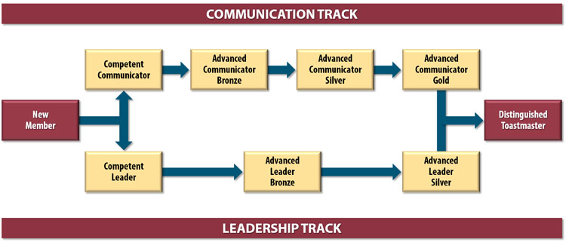
Current Educational Program
59 Projects
46 Speeches
1 hour workshop/class
2 Tracks (Paths)

Slide 3
Pathways Educational Program
Club Officer
District Officer
Club Mentor or Coach
Club Sponsor or Speechcraft or Youth Leadership Program
Chosen Path 1 (e.g., Presentation Mastery)
Level 1
Mastering Fundamentals
Level 2
Learning Your Style
Level 3
Increasing Knowledge
Level 4
Building
Skills
Level 5
Demonstrating Expertise
New
Member
Capstone Project
Distinguished Toastmaster
Chosen Path 2 (e.g., Team Collaboration)
Level 1
Mastering Fundamentals
Level 2
Learning Your Style
Level 3
Increasing Knowledge
Level 4
Building
Skills
Level 5
Demonstrating Expertise
59 Projects
27-30 Speeches
1 Capstone project
2 of 10 Paths

Slide 4
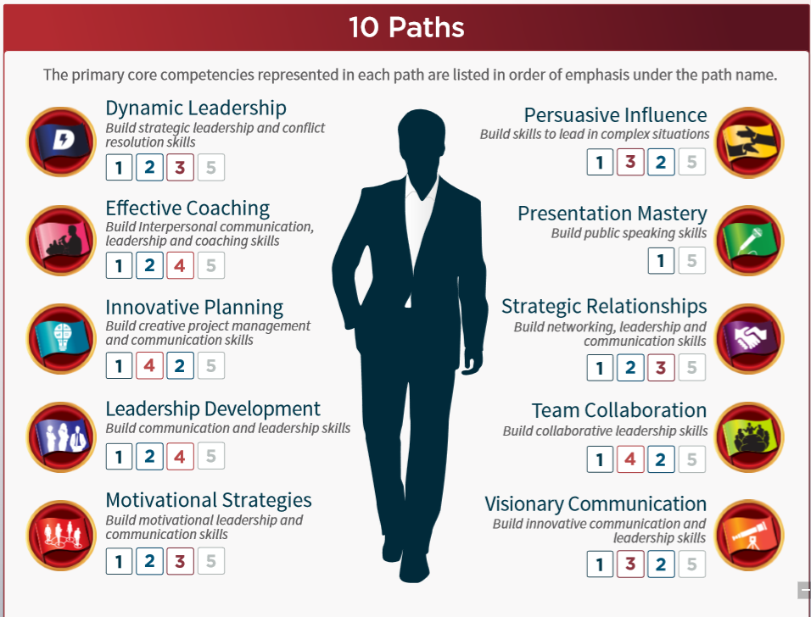
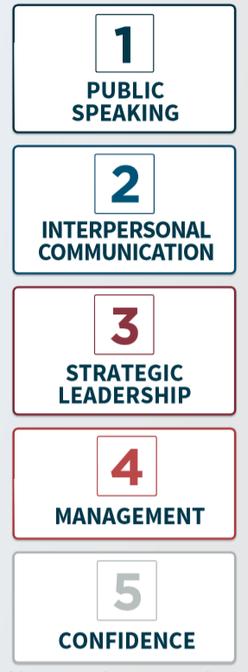
Paths develop Core Competencies
https://www.toastmasters.org/~/media/C74952D666414797BE9B165B739B7CF9.ashx

Slide 5
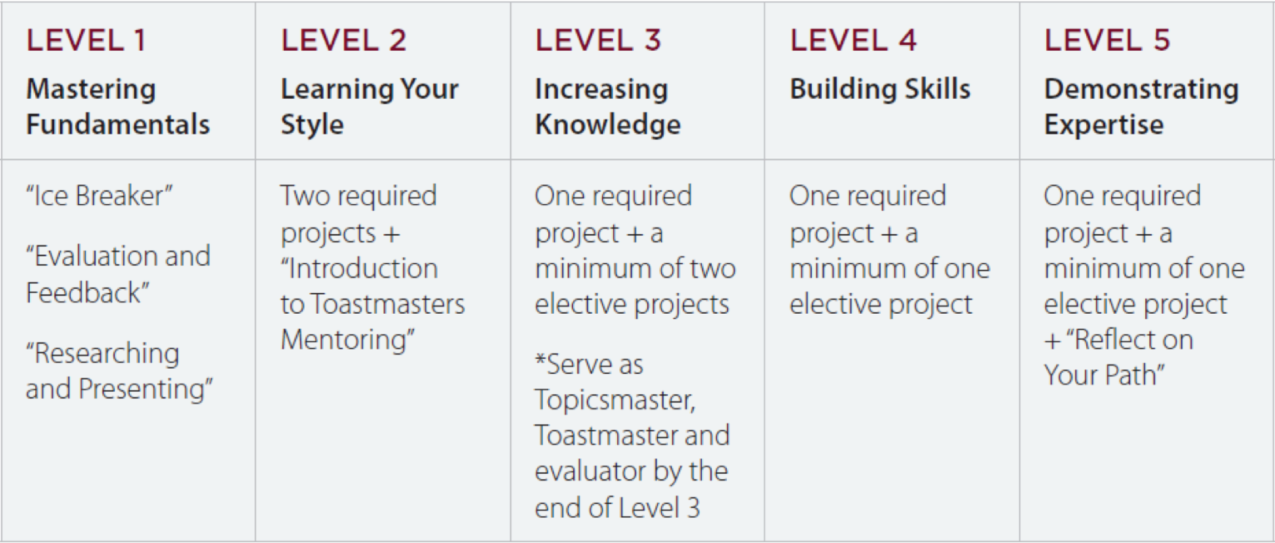
Levels and Project Types
More details can be found on the District 4 site:
http://www.d4tm.org/index.php/pathways/paths-and-projects.html

