Slide 1
Pathways Webinar /
Getting Started
Joe Hofmann, DTM
D18 Pathways Guide

Slide 2
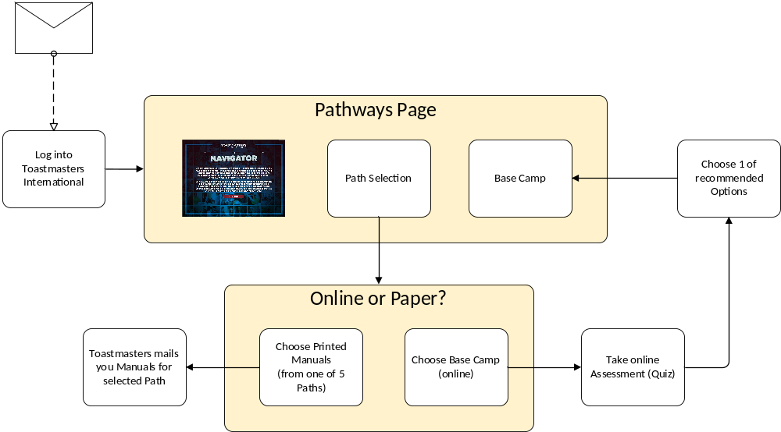
Process Overview
Email for Launch of Pathways

Slide 3

Getting Started

Slide 4
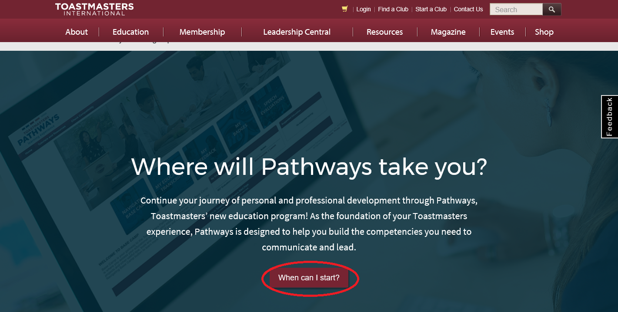
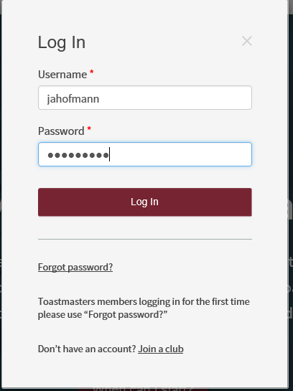
Getting Started

Slide 5
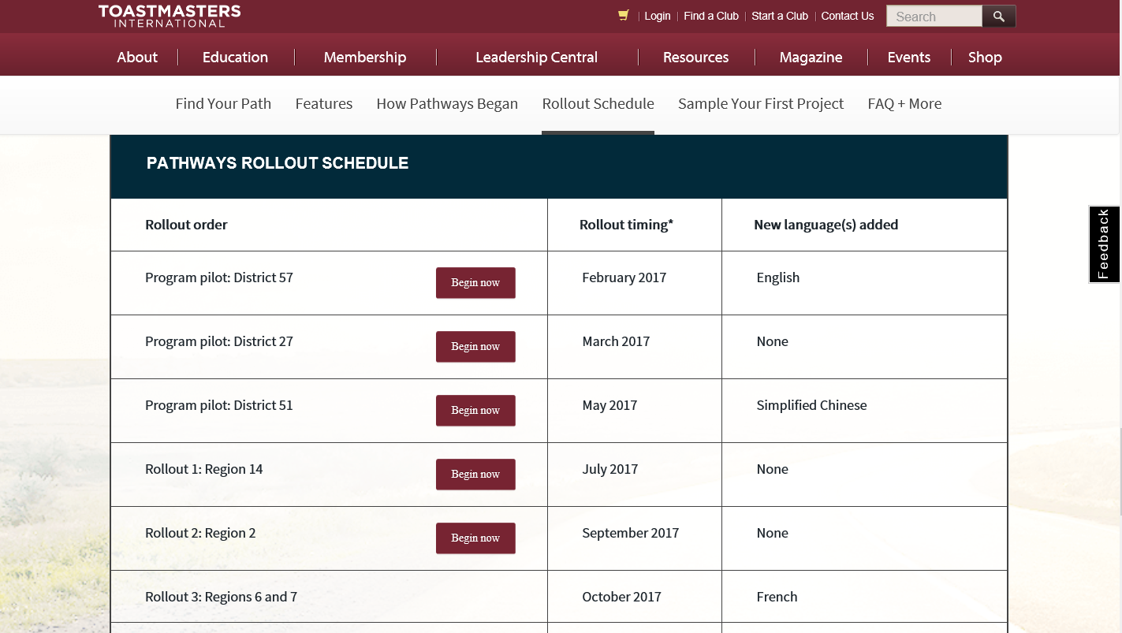
Getting Started

Slide 6
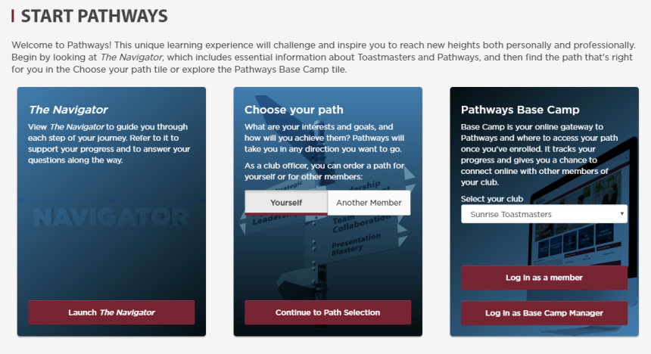
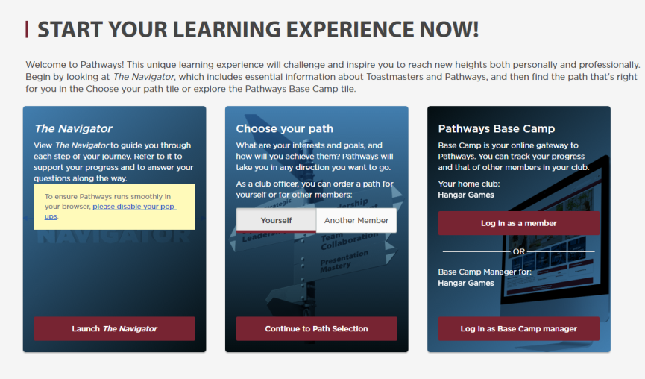
Pathways Page

Slide 7

Navigator – Guide to TM Program
Pathways Page

Slide 8
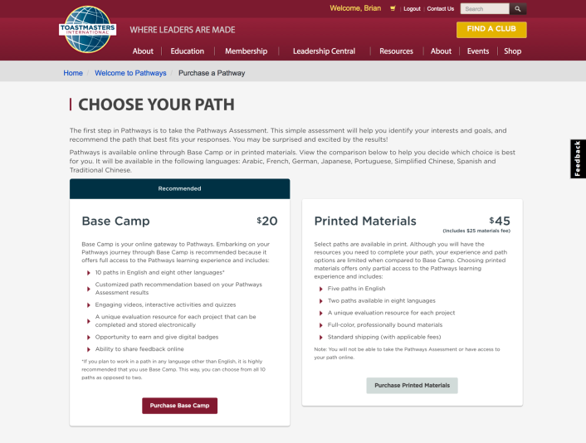
Online or Print

Slide 9
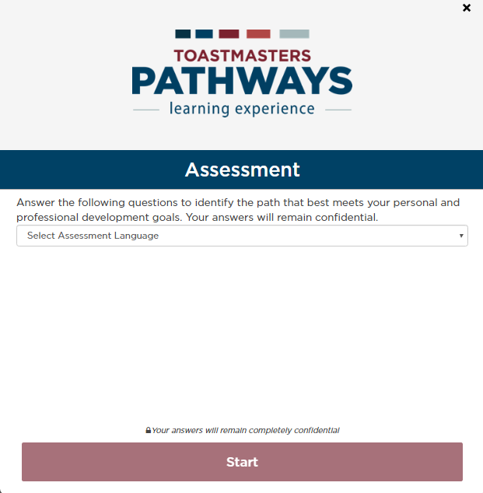
Pathways Assessment

Slide 10
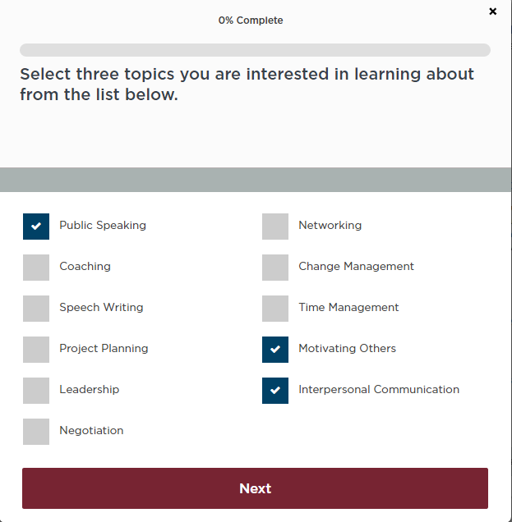
Pathways Assessment

Slide 11
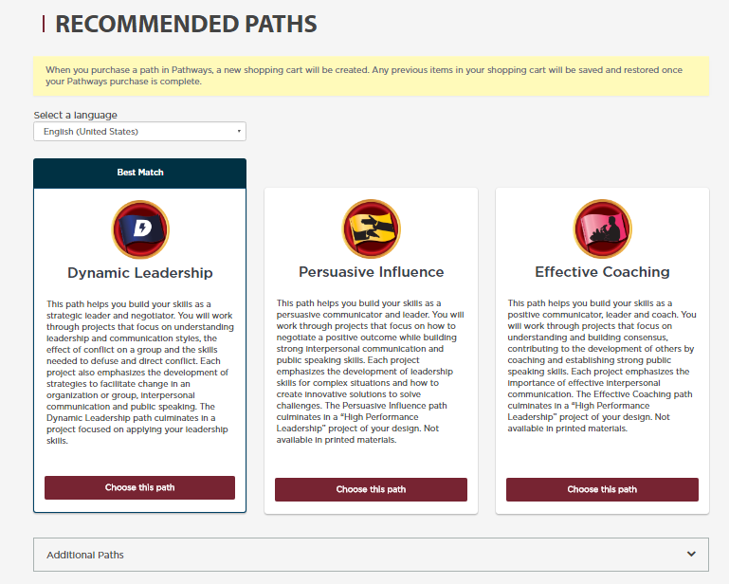
Pathways Assessment

Slide 12
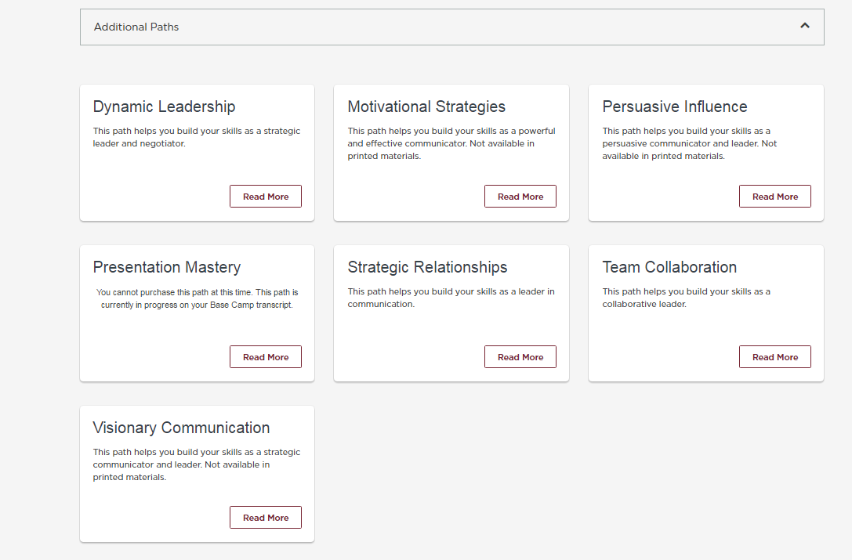
Pathways Assessment
Pathways Page

Slide 13
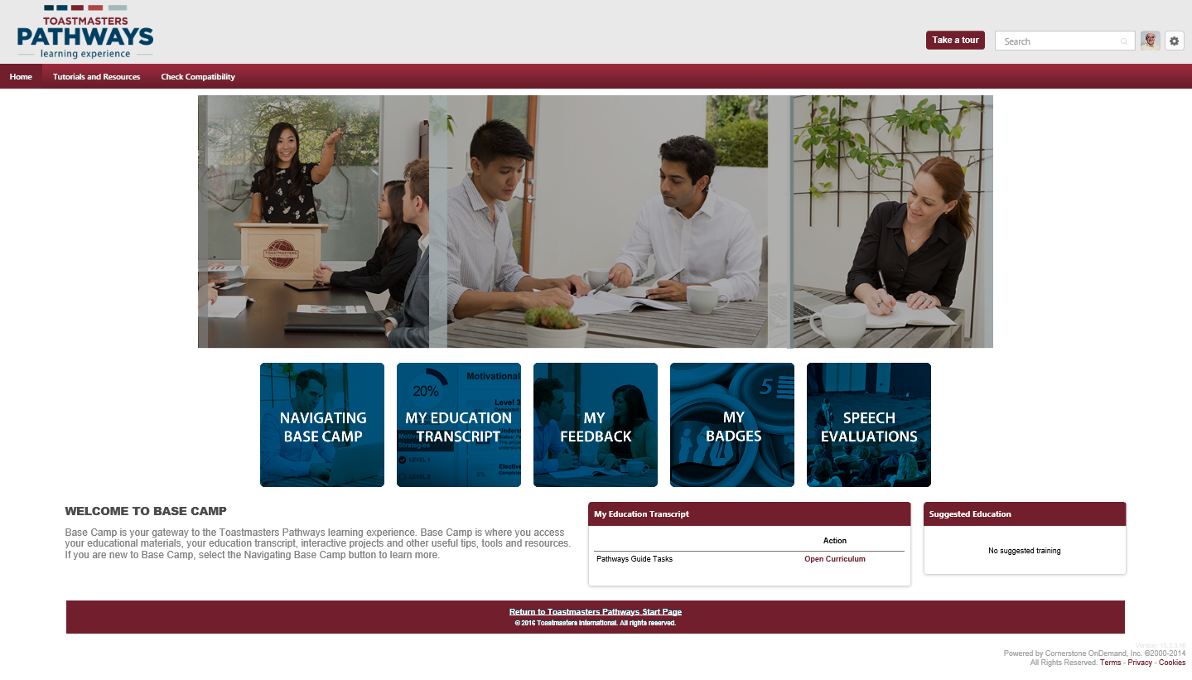
Base Camp
Pathways Page

