Slide 1



Slide 2
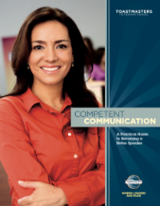
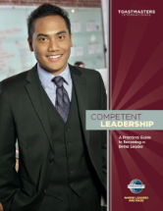
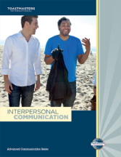


Education in Toastmasters
1924
1930-1940
Roberts Rules of Order
1950-1960
Basic Training
Beyond Basic Training
The Advanced Speaker
1996
2017
Current Toastmasters Program
Pathways Launched
Manual of Instructions
Ten Lessons in Public Speaking

Slide 3

Toastmasters Learning Revitalized
Competency-based
High value (many options)
Fun
Customized to your needs
Flexible
Resource-rich
Meaningful, effective evaluations

Slide 4
You Choose the Experience
Tailored, self-paced learning
Flexibility to choose experience
Greater access to materials
Expanded resources
Real-world applicability

Slide 5
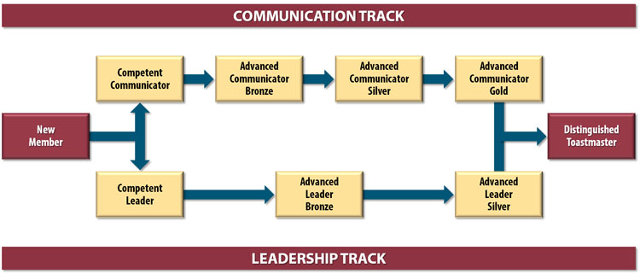
Current Educational Program
59 Projects
46 Speeches
1 hour workshop/class
2 Tracks (Paths)

Slide 6
Pathways Educational Program
Club Officer
District Officer
Club Mentor or Coach
Club Sponsor or Speechcraft or Youth Leadership Program
Chosen Path 1 (e.g., Presentation Mastery)
Level 1
Mastering Fundamentals
Level 2
Learning Your Style
Level 3
Increasing Knowledge
Level 4
Building
Skills
Level 5
Demonstrating Expertise
New
Member
Capstone Project
Distinguished Toastmaster
Chosen Path 2 (e.g., Team Collaboration)
Level 1
Mastering Fundamentals
Level 2
Learning Your Style
Level 3
Increasing Knowledge
Level 4
Building
Skills
Level 5
Demonstrating Expertise
59 Projects
27-30 Speeches
1 Capstone project
2 of 10 Paths

Slide 7
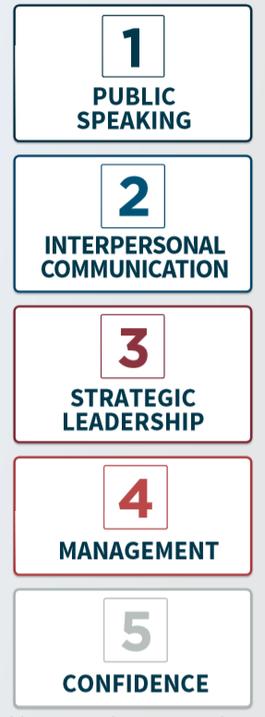
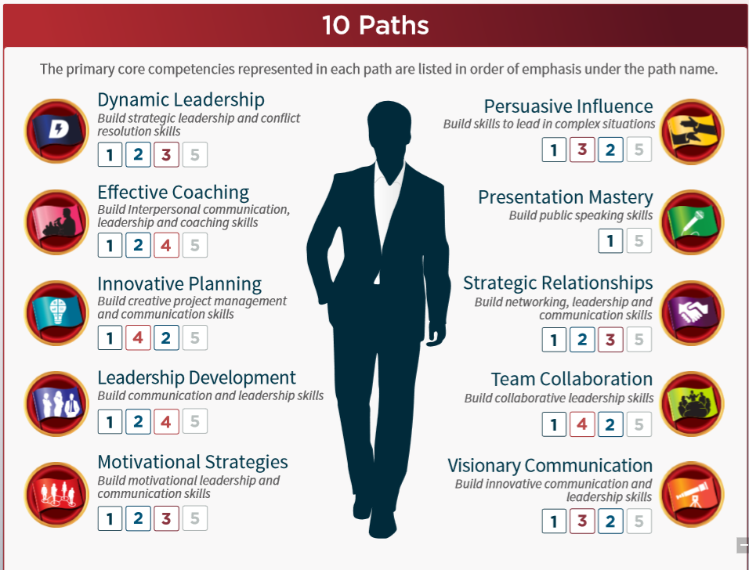
Paths develop Core Competencies
https://www.toastmasters.org/~/media/C74952D666414797BE9B165B739B7CF9.ashx

Slide 8
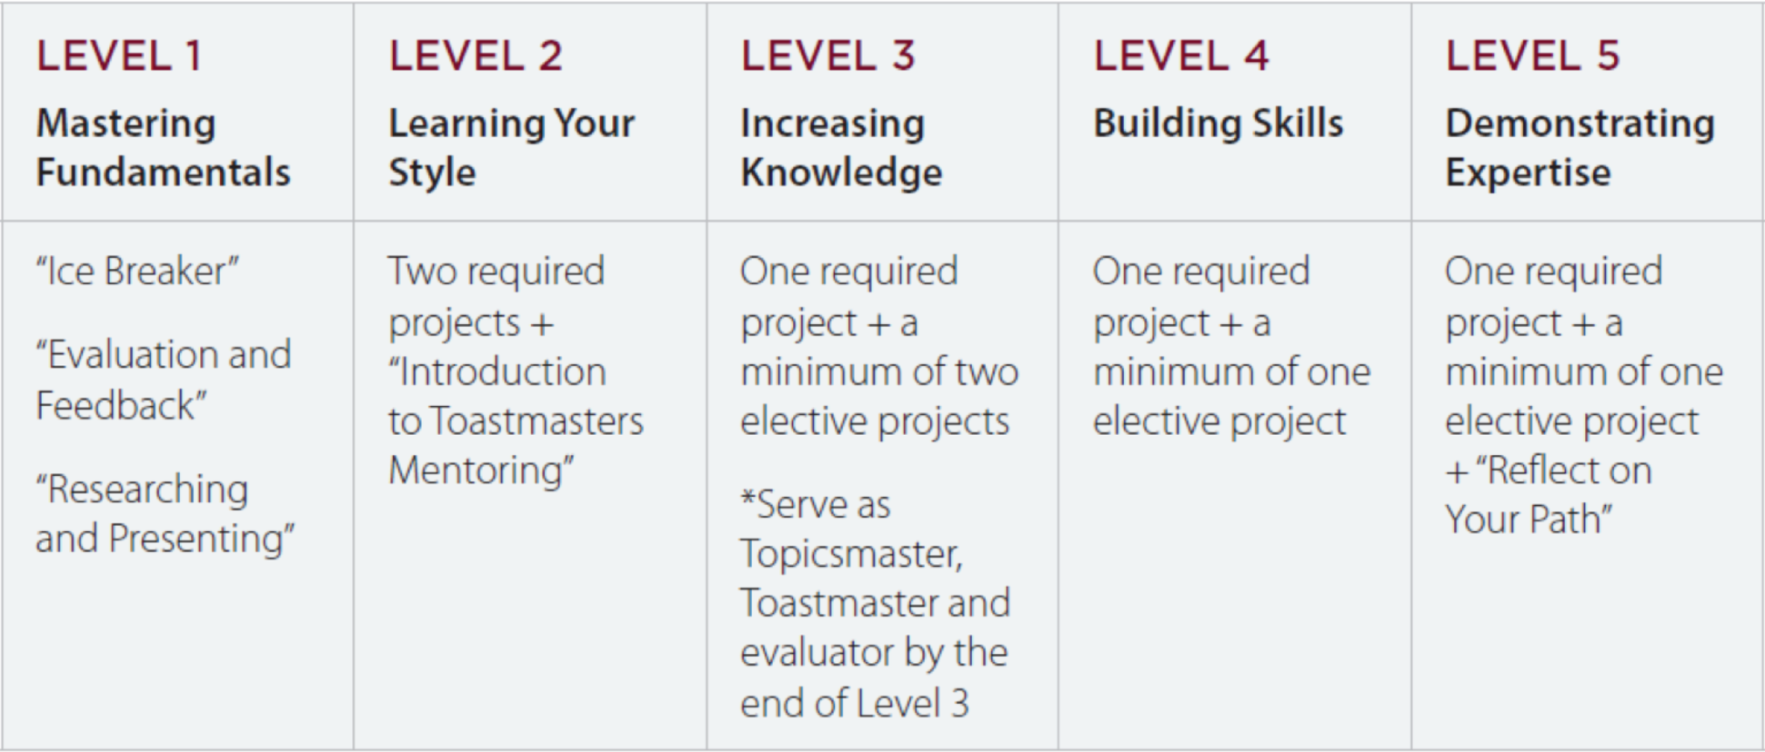
Levels and Project Types
More details can be found on the District 4 site:
http://www.d4tm.org/index.php/pathways/paths-and-projects.html

Slide 9






59 Projects
English
Simplified Chinese
Traditional Chinese
Japanese
Spanish
Portuguese
French
German
Arabic
Accessibility for sight-impaired: Phase 2

Slide 10







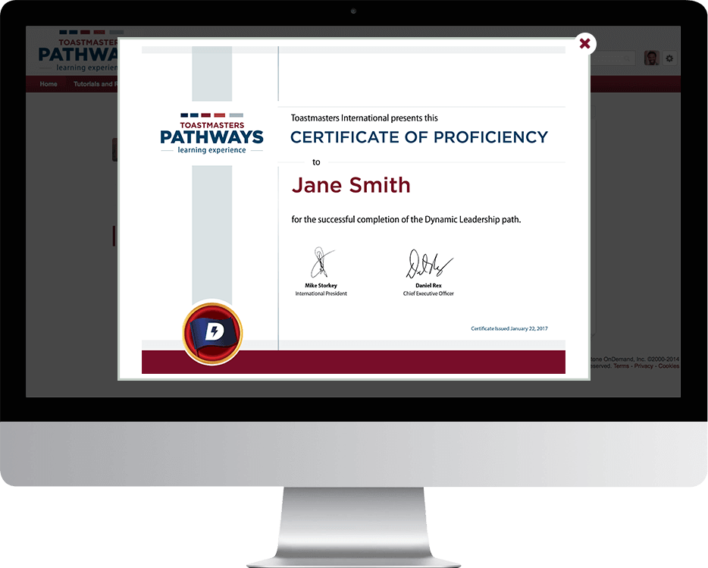


Badges and Awards

Slide 11
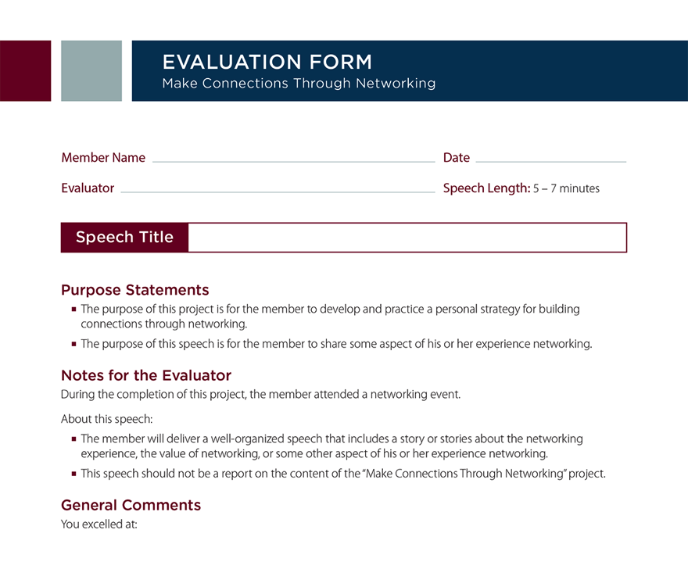
Evaluations

Slide 12
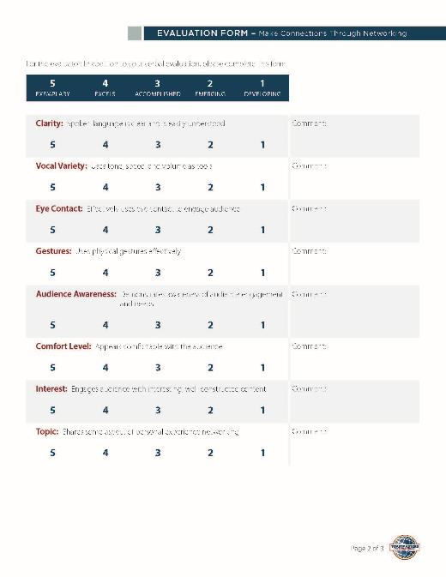
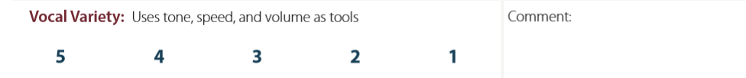

Slide 13
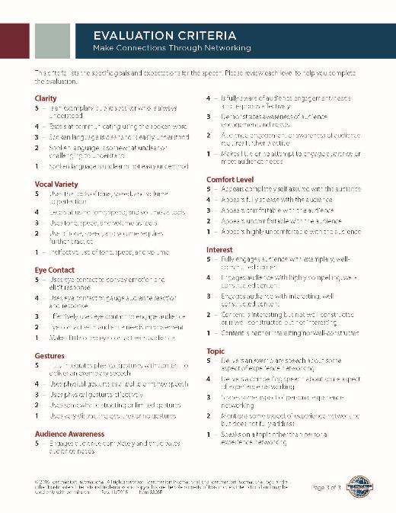
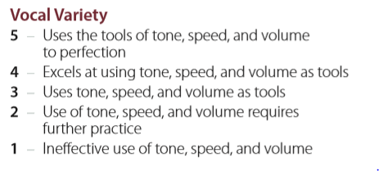

Slide 14

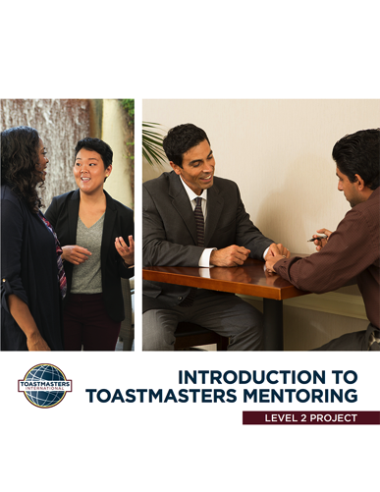


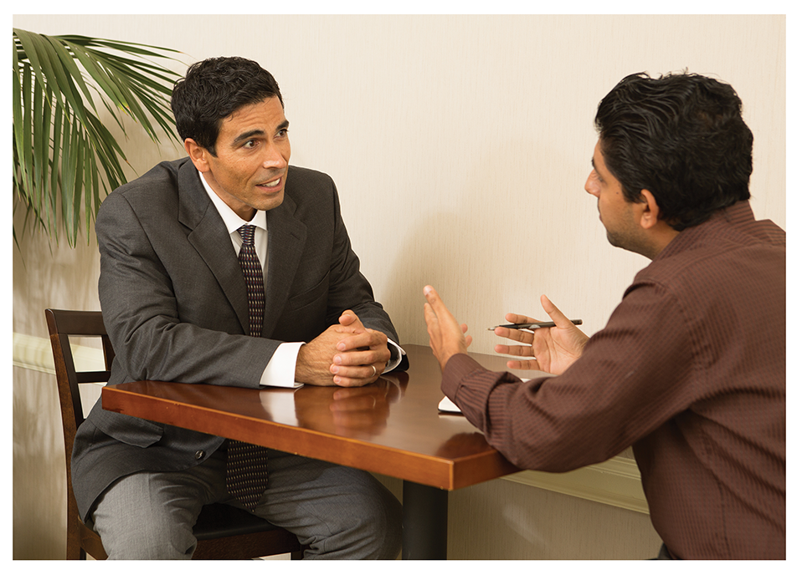


PATHWAYS MENTOR PROGRAM

Slide 15
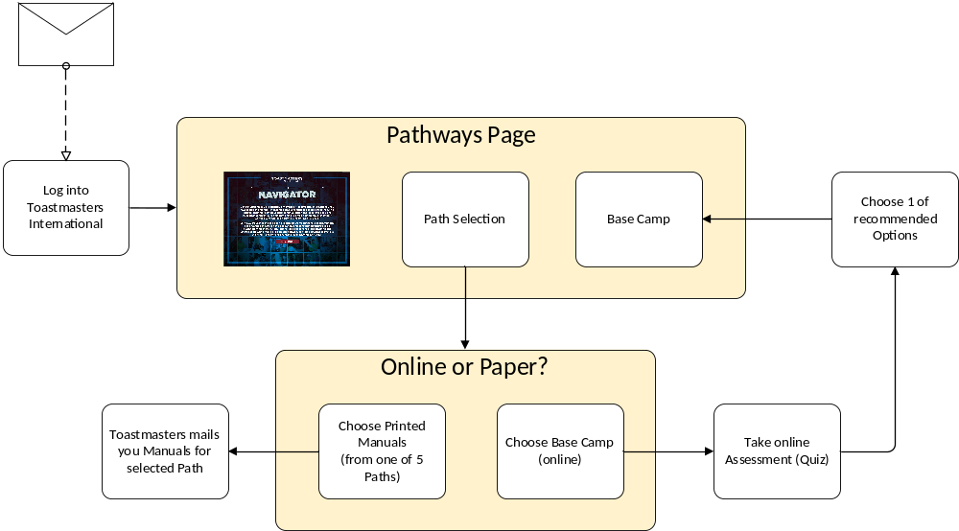
Getting Started
Email for Launch of Pathways

Slide 16
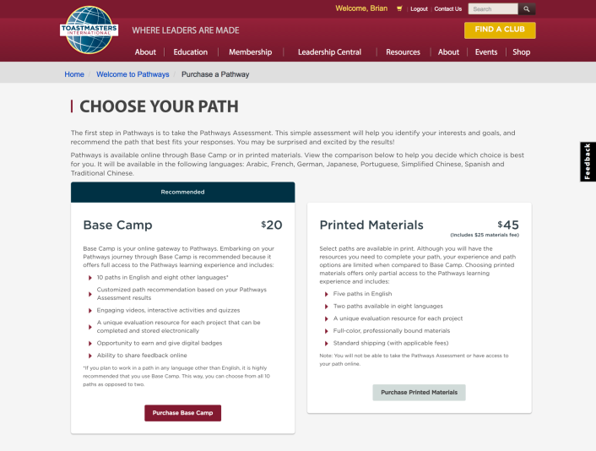
Online or Print

Slide 17
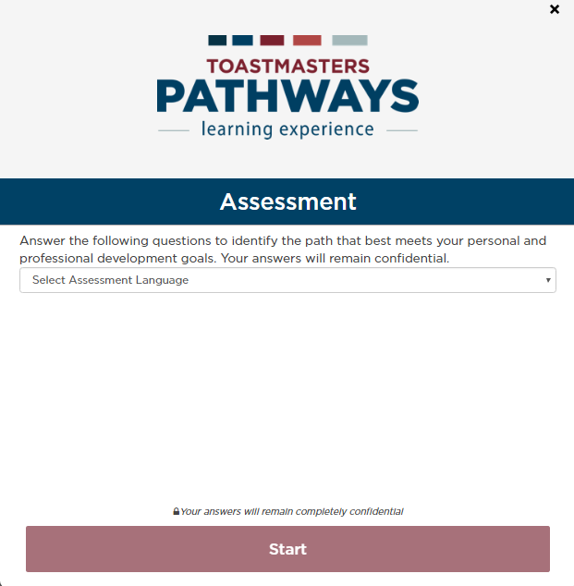

Slide 18
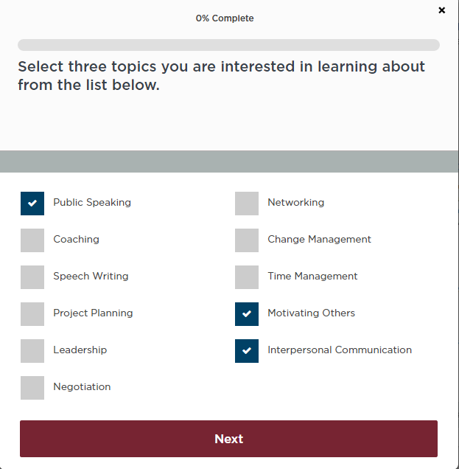

Slide 19
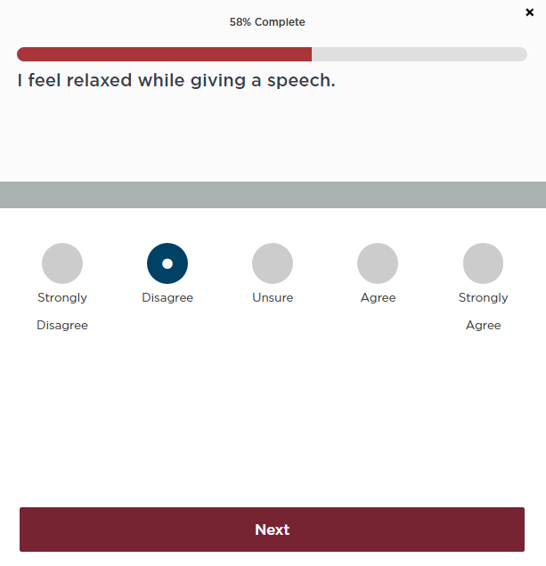

Slide 20
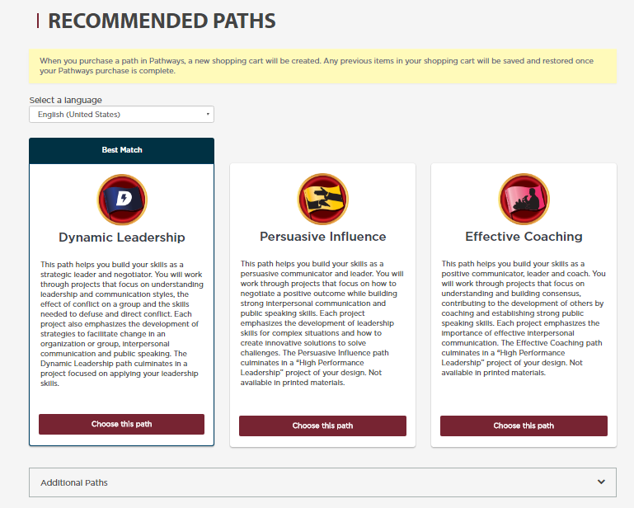

Slide 21
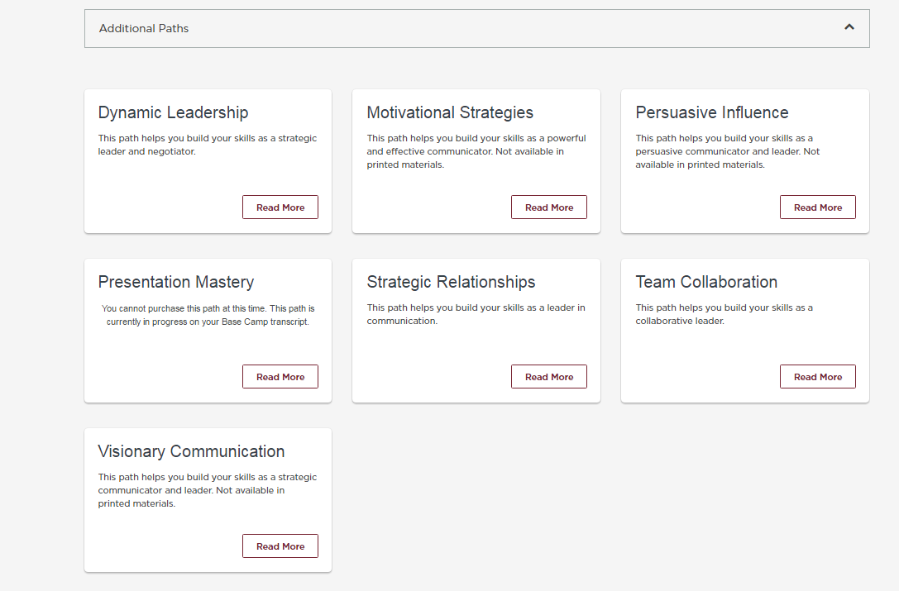

Slide 22
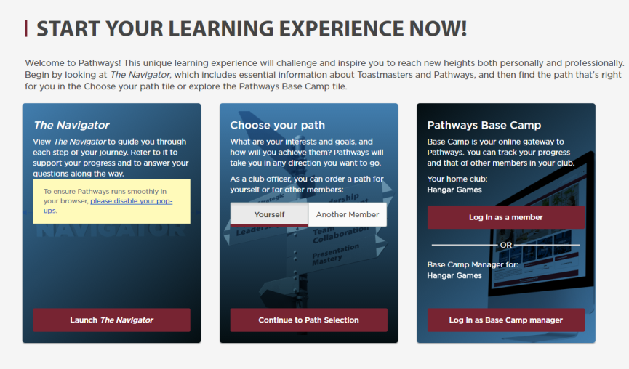
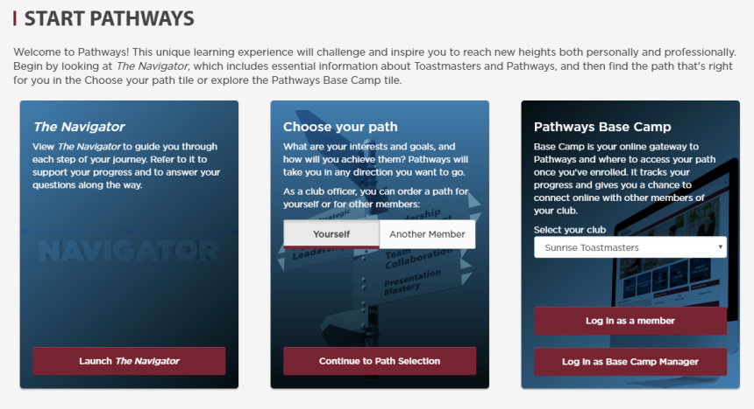

Slide 23
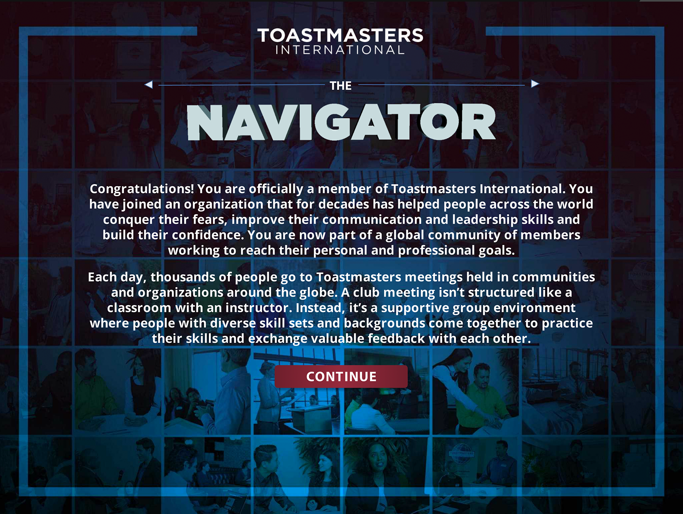
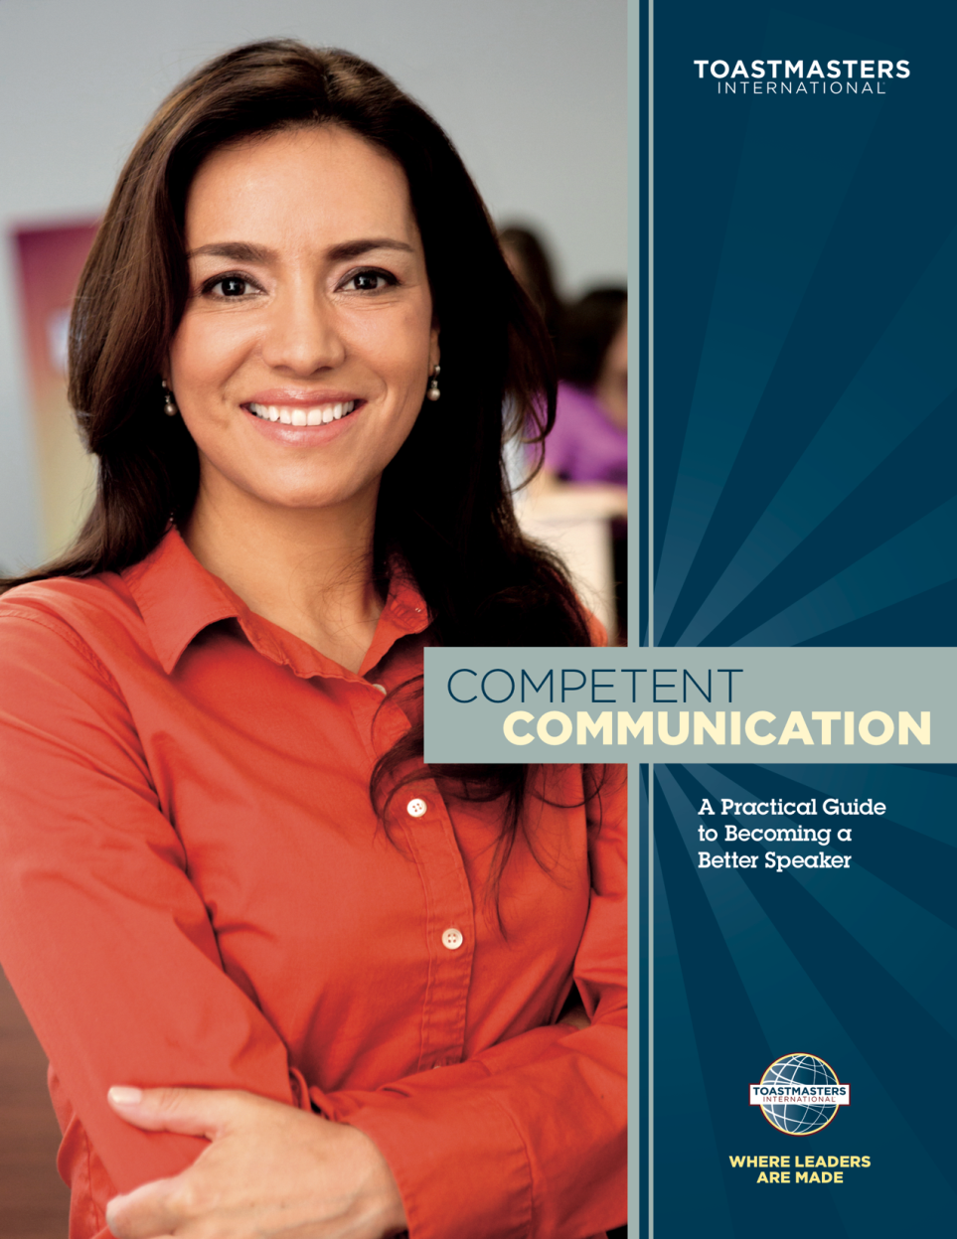
REACHING YOUR CURRENT EDUCATION GOALS

Slide 24
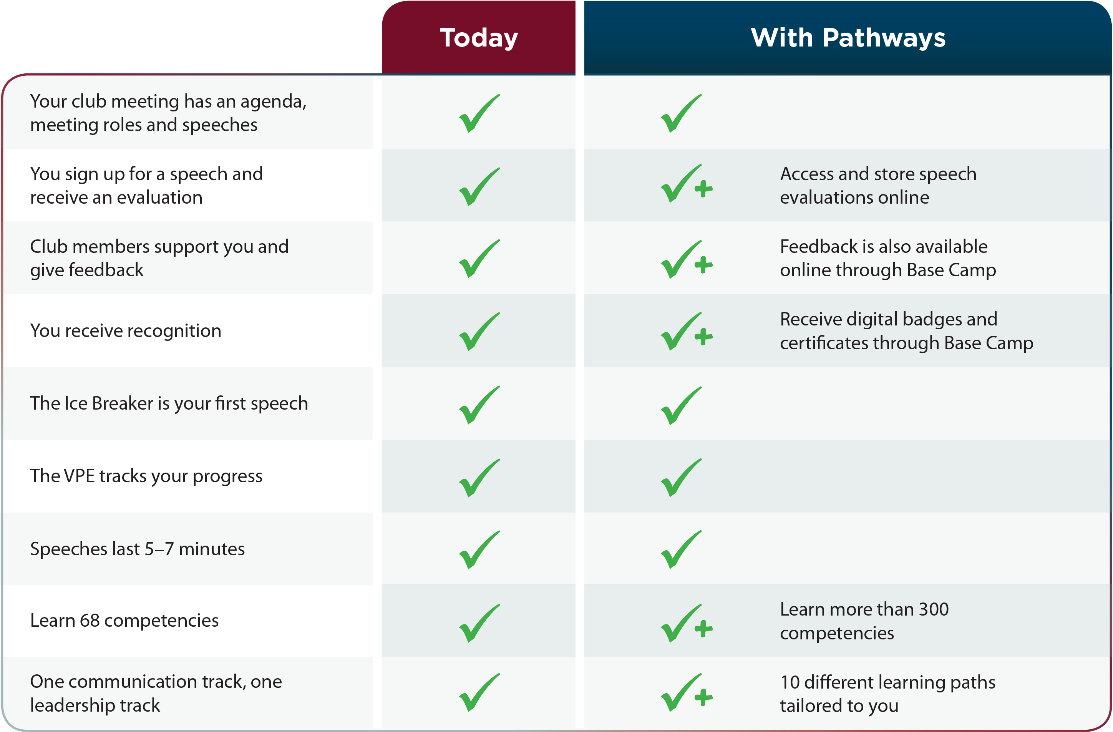
Pathways Doesn’t Change the Club Meeting

Slide 25
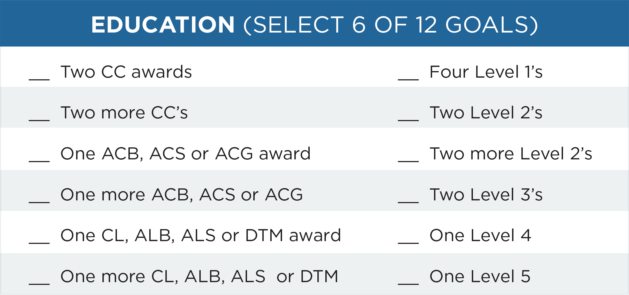
Distinguished Club Program

Slide 26

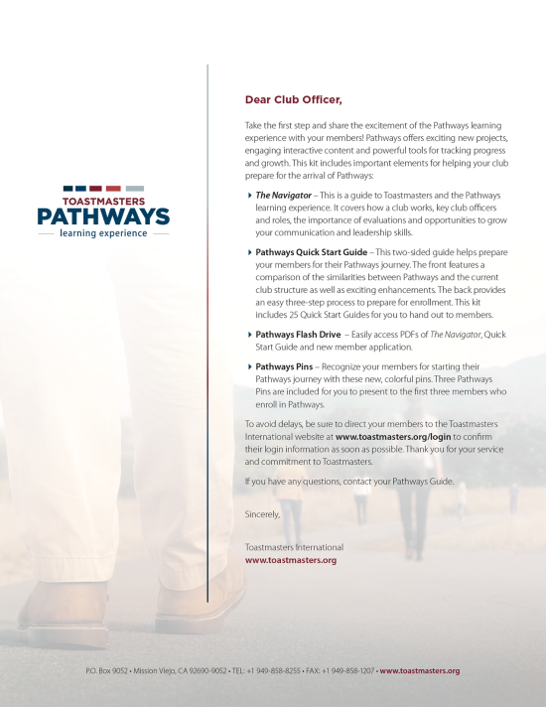
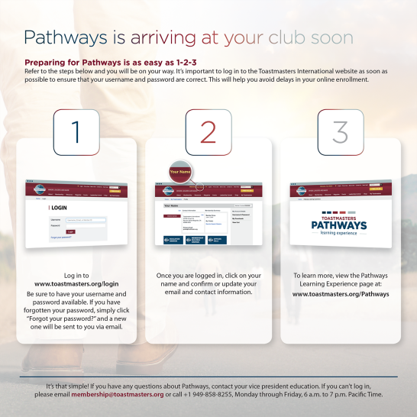
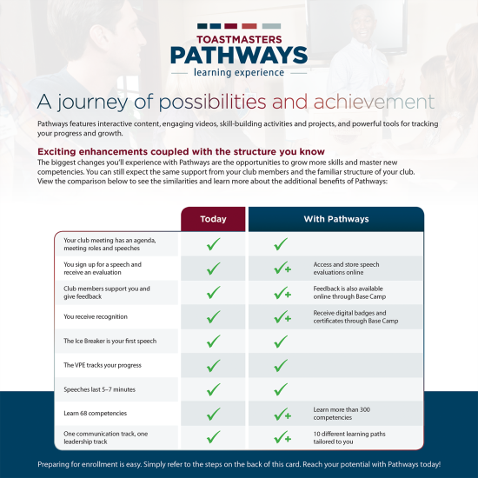


How to Get Started (rollout kit)

Slide 27
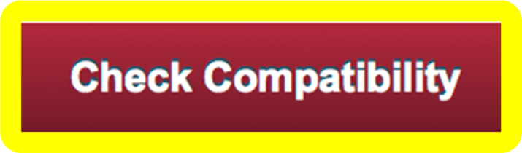
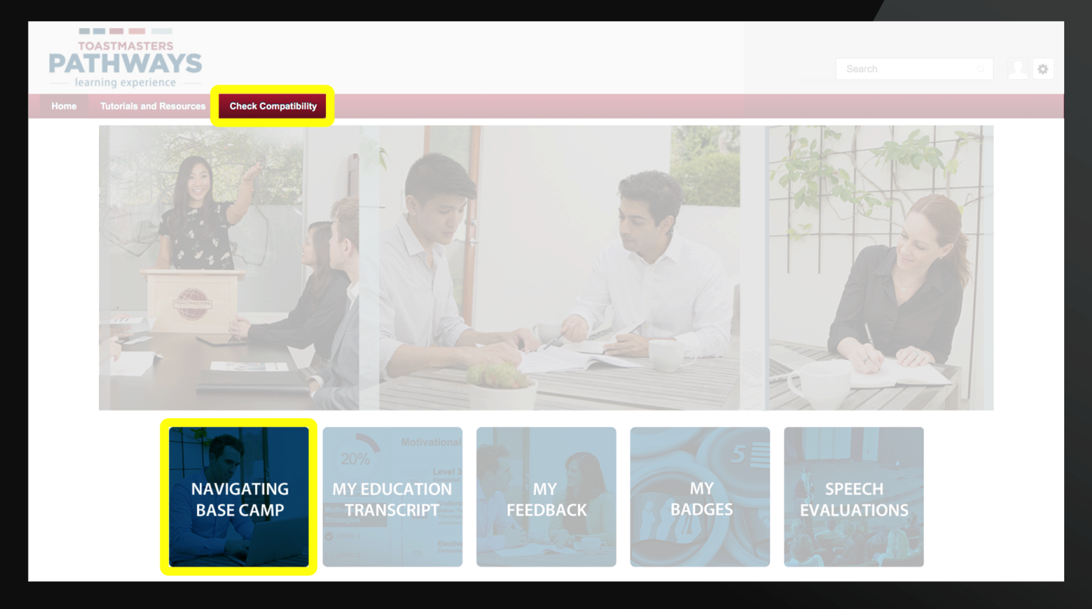

OTHER HELPFUL TIPS

Slide 28
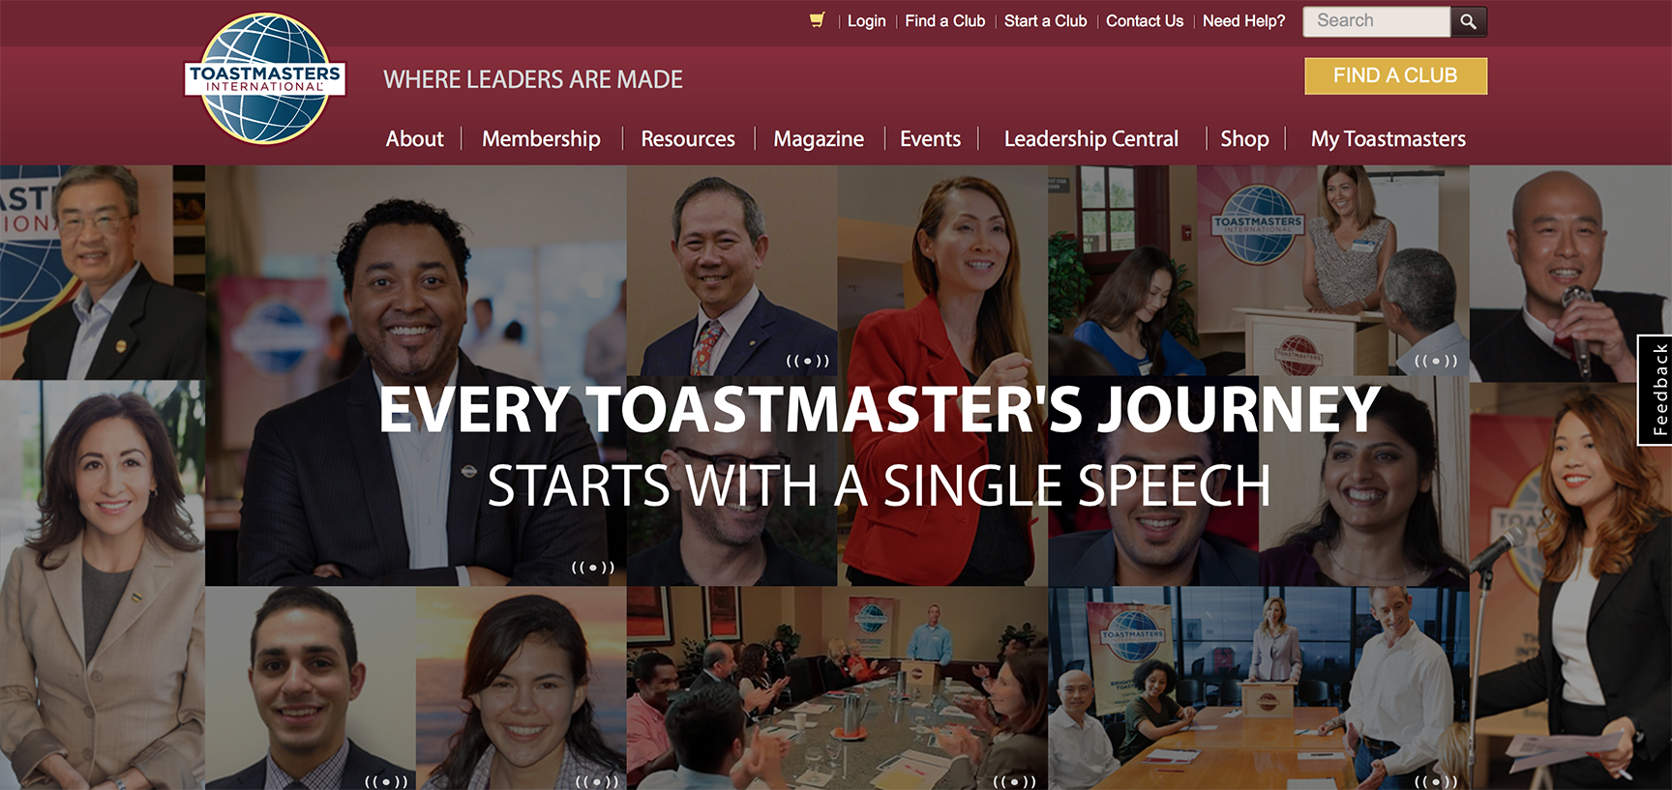
LET’S LOG IN TOGETHER

Slide 29
Local Support Team
District
  District Leadership Team
  Chief Ambassador
  Ambassadors
  Pathways Guides
Club
  VP Education
  President
  Secretary

Slide 30


